Slide 1


K.RAMAKRISHNAN COLLEGE OF TECHNOLOGY (AUTONOMOUS), TRICHY
Comparing Average Rainfall in Two Different Cities
PRESENTED BY
OM PRAKASH M-ADB23079

Slide 2
PRESENTATION OVERVIEW
Problem Identification
Objective
Proposed system
Block Diagram of proposed system
List of modules
Module implementation
R Data structure used

Slide 3
PRESENTATION OVERVIEW
Source code
Screenshot
Advantages of proposed system
Conclusion

Slide 4
PROBLEM IDENTIFICATION
Data Availability: Cities often have different climates, and rainfall is one of the most important climate variables that influence various aspects of life.
Understanding Rainfall Patterns: It’s important to compare the average rainfall between two cities to analyze the differences and identify any trends.
Urban Planning & Agriculture: Accurate rainfall data is crucial for urban planning, agriculture, and resource management.
Challenge: Lack of standard methods to compare rainfall patterns for different regions using statistical and visual analysis.
2/7/20

Slide 5
OBJECTIVE
Comparison of Average Rainfall: The primary goal is to compare the average rainfall between two cities to understand climate differences.
Use of Statistical Methods: Apply statistical analysis and R programming to compute and visualize average rainfall comparisons.
Provide Insights for Decision-Making: Aid policymakers, planners, and researchers in making informed decisions based on comparative rainfall data.
Make Visual and Quantitative Comparisons: Use data visualization techniques (such as bar charts, box plots, etc.) in R to illustrate the comparison effectively.

Slide 6
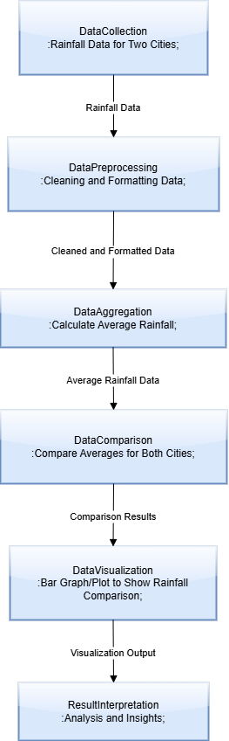
PROPOSED SYSTEM BLOCK DIAGRAM

Slide 7
LIST OF MODULES
Data Collection Module
Data Storage and Management Module
Prediction and Forecasting Module
Alert and Notification Module

Slide 8
MODULE IMPLEMENTATION
Data Collection Module: Gathers rainfall data from various sources.
Data Storage and Management Module:Stores and organizes rainfall data for easy retrieval and analysis.
Prediction and Forecasting Module: Uses historical data to forecast future rainfall patterns.
Alert and Notification Module: Sends notifications to users about significant rainfall

Slide 9
R DATA STRUCTURED USED
Data Frames:
A data frame is an essential structure in R for storing data. It allows you to store data in a tabular format (rows and columns), which is perfect for handling data like dates and rainfall amounts.
Vectors:
A vector can be used to store individual rainfall values for each city. You can then calculate the average rainfall for each city using basic R functions.
List:
You can store rainfall data for multiple cities or multiple variables for each city, such as rainfall, temperature, and humidity.
Array:
Store data in more than two dimensions (e.g., cities, months, years). This is especially useful for more complex analyses or comparisons.

Slide 10
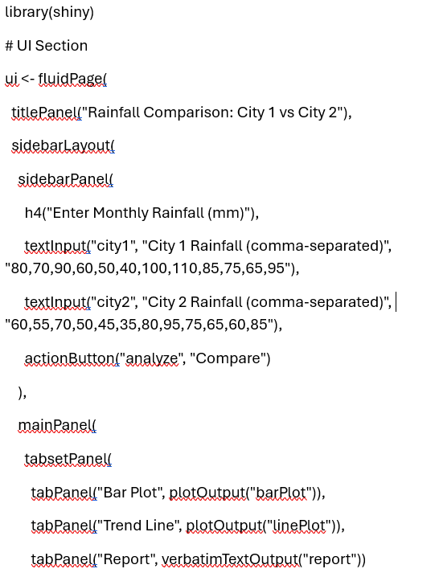
SOURCE CODE

Slide 11
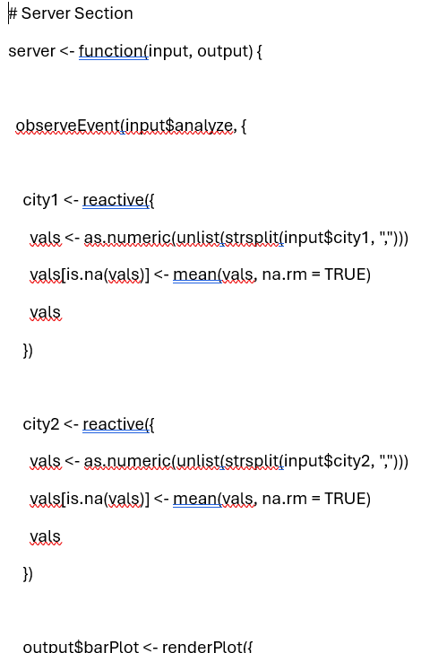
SOURCE CODE

Slide 12
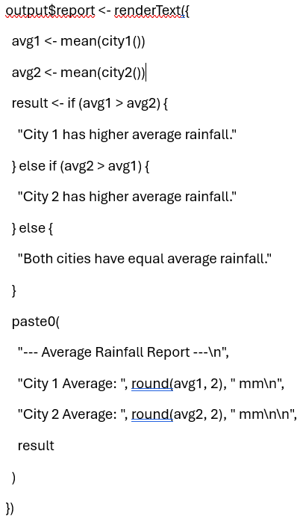
SOURCE CODE

Slide 13
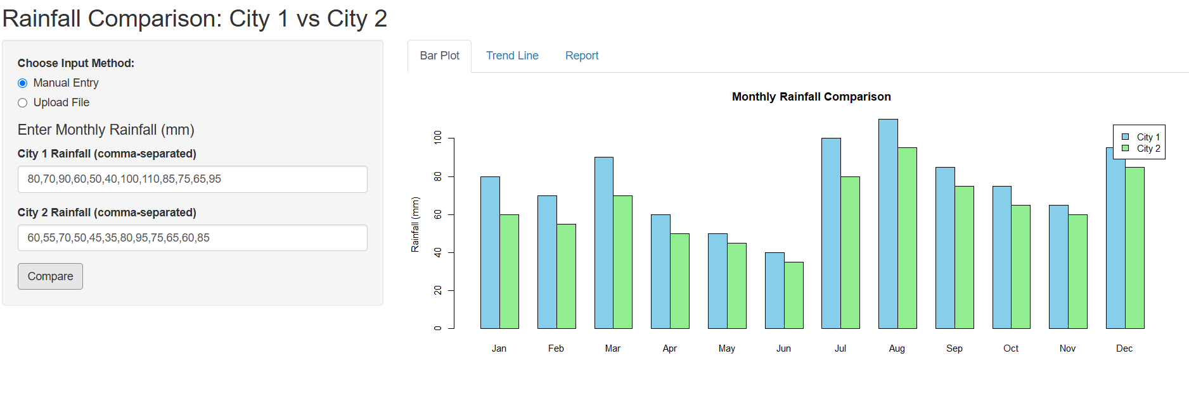
SCREENSHOT

Slide 14
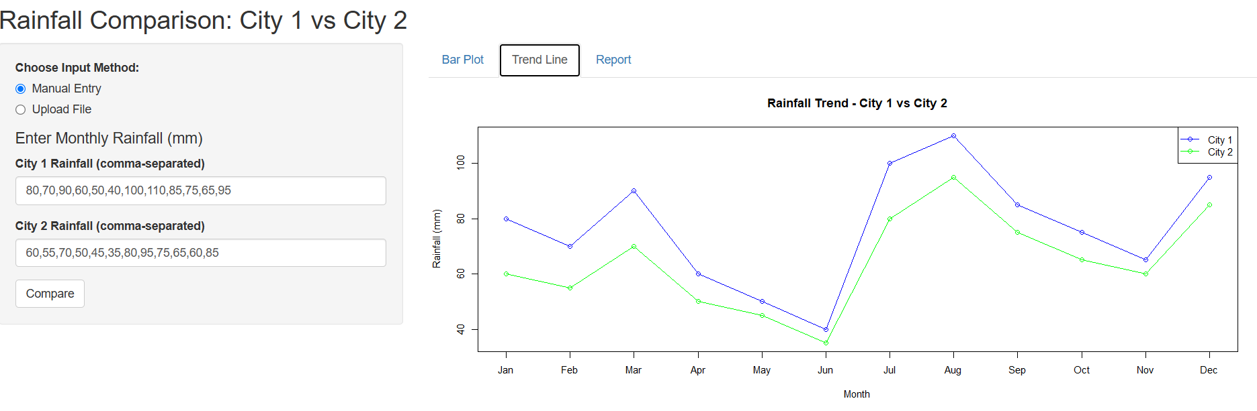
SCREENSHOT

Slide 15
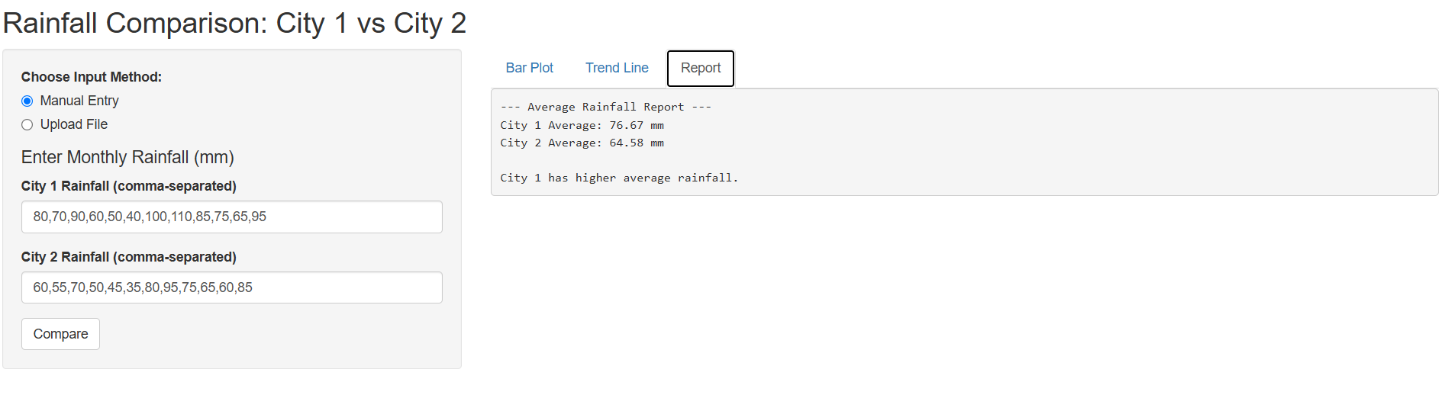
SCREENSHOT

Slide 16
ADVANTAGES OF PROPOSED SYSTEM
Flexibility & Scalability: Can compare multiple cities or other environmental factors.
Cost-Effective: Open-source R programming reduces software costs, accessible for all budgets.
Real-Time Analysis: (Optional) Integrates with live data for continuous analysis and decision-making.
User-Friendly Interface: Results are presented in a format easy to understand for all stakeholders.
Supports Hypothesis Testing: Validates significant rainfall differences with statistical methods.

Slide 17
CONCLUSION
In conclusion, the "Comparing Average Rainfall of Two Cities" project effectively utilizes R and Shiny to provide a user-friendly, interactive platform for rainfall analysis. It enables users to input or upload data, visualize trends, and generate statistical comparisons easily. The application simplifies complex data through clear graphs and reports. Proposed features like forecasting and alerts further enhance its utility. Overall, it offers a practical tool for informed decision-making based on rainfall patterns.

Slide 18
THANK YOU

